Slide 1



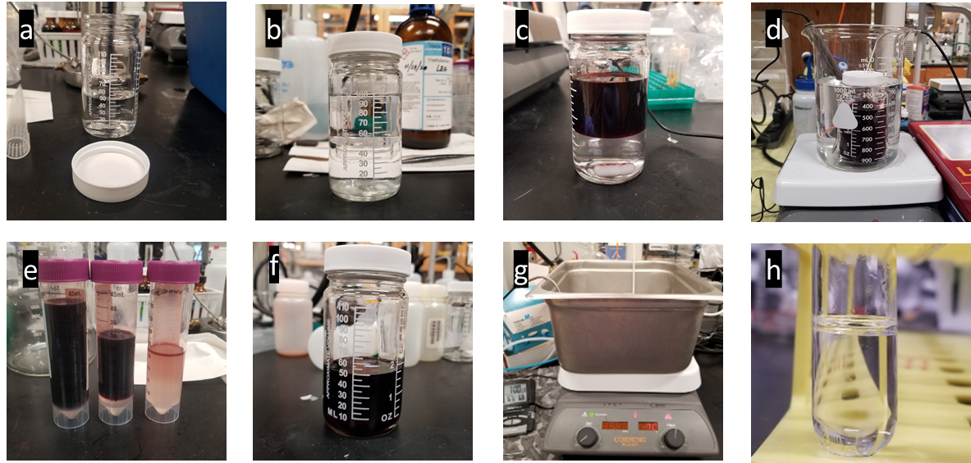
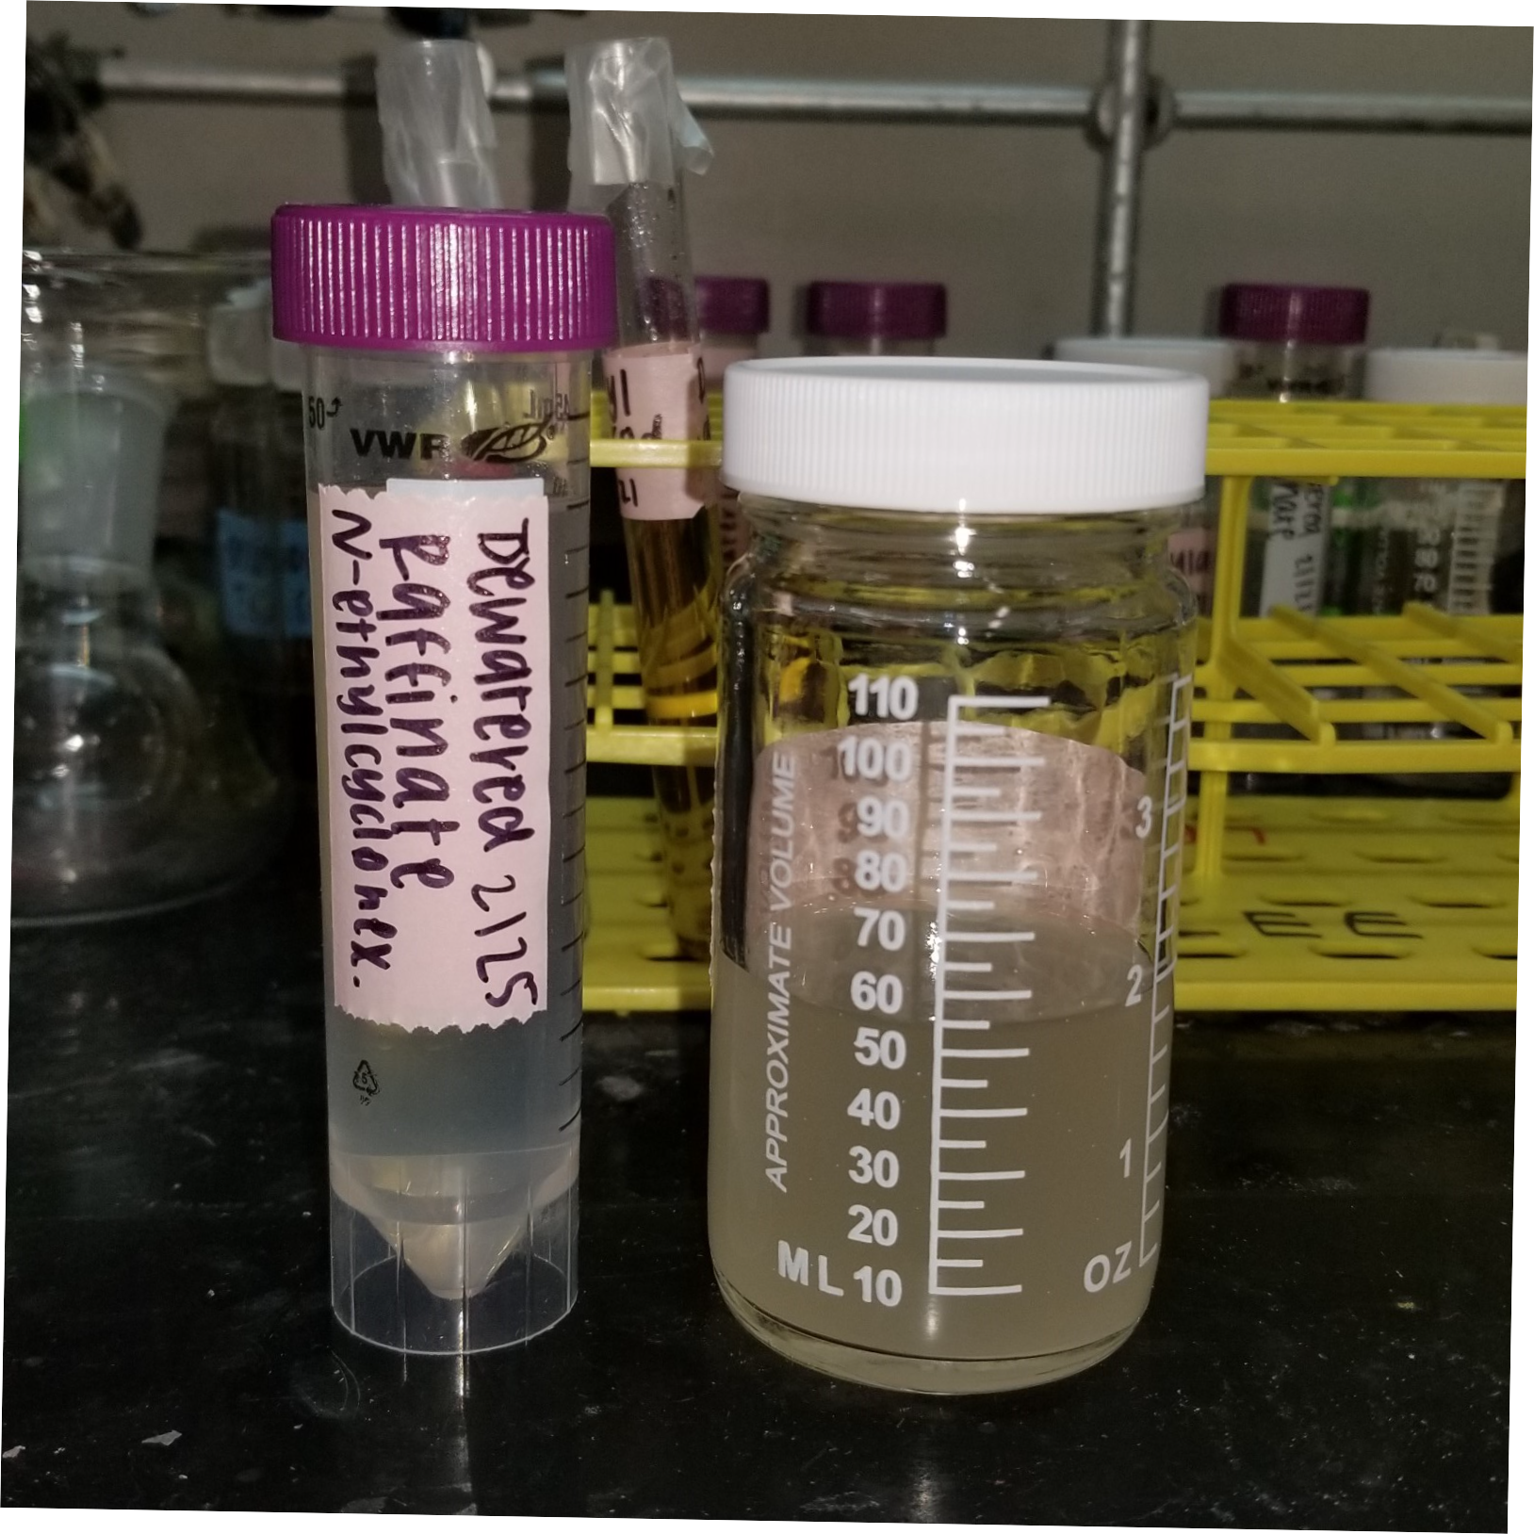
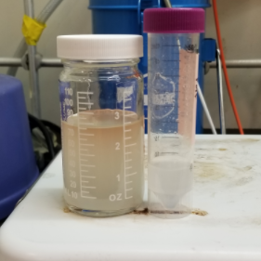
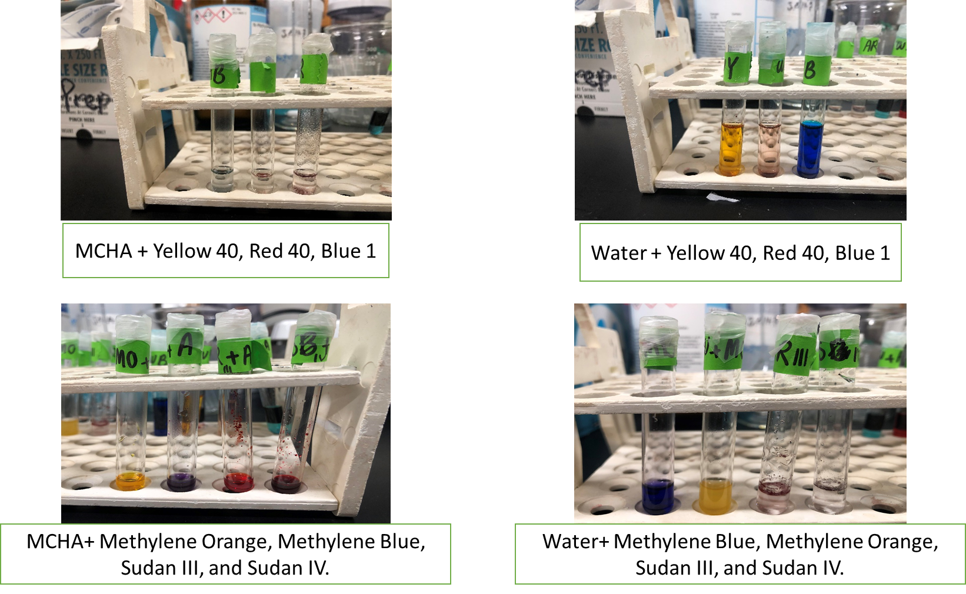
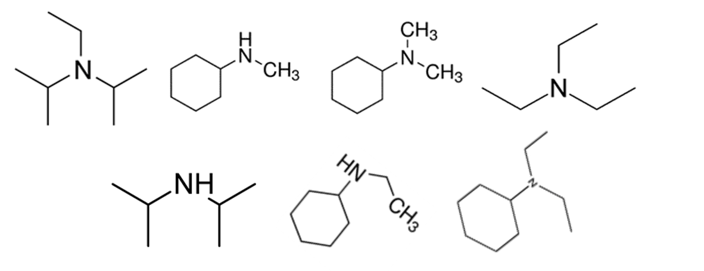
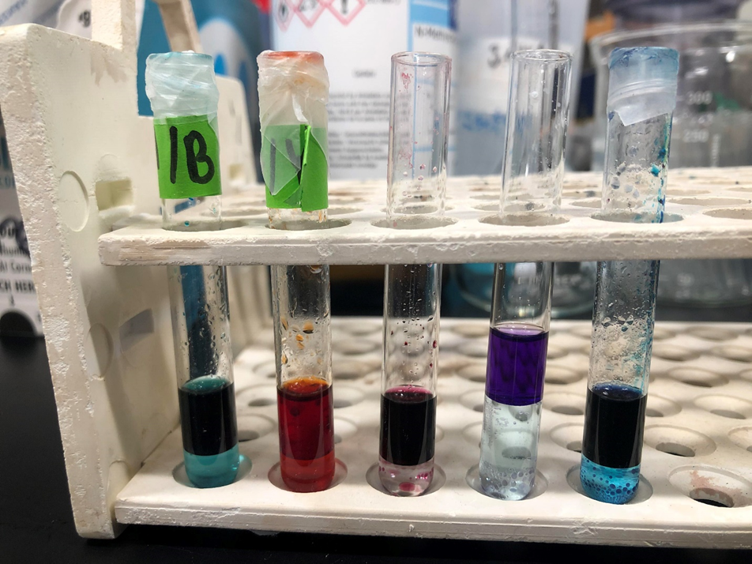
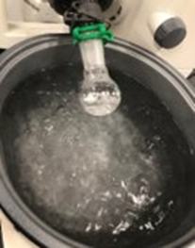
Drinking Water Production Using Temperature Swing Solvent Extraction
Kem, Diana; Lee, Seungjin
School of Science and Technology, Georgia Gwinnett College, Lawrenceville, GA
Introduction
Table 2. Recent amine data that has been scaled up from previous semester.
Amine | Product Water Recovered (g) | Concentrated Saline Brine Recovered (mL)
Triethylamine | 2.892 | ~40.0
N-Ethylcyclohexylamine | 8.879 | ~40.0
N-Methylcyclohexylamine | -- | ~25.0
Diisopropylamine | 14.431 | ~28.0
Temperature swing solvent extraction (TSSE) is an effective technique characterized by membrane-less desalination and being a low energy, cost-effective alternative for saline feeds. While the application of TSSE in desalination has been studied, little is known about the effect of different amines on the efficiency of the technology. Through a cycle of temperature swing extraction experiments conducted for each type of amine, product water is extracted and analyzed.
Objectives and Approach
Figure 1. (A) 1 M saline solution (B) Amine added into vial, layers separate (C) Sudan IV red dye added into vial (visualize layers) (D) Low temperature water bath at 16°(E) Amine and water layer and dewatered raffinate (F) Amine and water layer separated (G) High temperature water bath at 68°and (H) Product water extracted
The objective of this research is to focus on the systematic elucidation of the parameters influencing the TSSE.
In particular, the comparison of the affinity of secondary and tertiary amines to produce potable water. Various amines were chosen to test the effect of degree of substitution as well as comparisons between amines with similar types of functional groups on the extraction performance.
Figure 3. Comparison between amine water affinity after low temperature water bath. They are N-Ethylcyclohexylamine and N-Methylcyclohexylamine, respectively. Both are secondary structures.
Results
Conclusions
Sudan IV red dye chosen as the most viable option for identification.
A larger volume of water was recovered from the extraction with secondary amines using the same volume of solvents.
There is also differential affinity of solvents to water with amines containing similar moieties. Lower volumes of saline water show a higher amine affinity for water.
Noticeable differences in the efficiency of water extraction from highly concentrated brine are found for secondary and tertiary amines.
Methods
Future Work
Dyes to visually demonstrate a clear separation
TSSE experiments utilizing low and high temperature swing
Product water analysis:
Mass of water recovered
Residual salt concentration and amine concentration:
Rotary Evaporator and TOC analyzer
Further tests with varying experimental conditions to be conducted.
Conclusive extraction results and analysis of the correlation among parameters will be presented.
Include additional set of extraction experiments using asymmetric substituents and the optimization of the extraction temperature for individual amines.
Figure 2. Dye tests ran on amine and water layer for identification.
Table 1. Data of amines that Boo’s paper also tested. It consists of two secondary and one tertiary amine.
Amine | Product Water Recovered (g) | Salt Recovered (g) | Concentrated Saline Brine Recovered (mL)
Diisopropylamine | 0.8 | 0.22 | ~1.6
Diisopropylethylamine | 0.1 | 0.21 | ~1.8
N,N-Diethylcyclohexylamine | 0.2 | -- | ~2.0
References:
Boo, C., Winton, R. K., Conway, K. M., & Yip, N. Y. (2019). Membrane-less and Non-Evaporative Desalination of Hypersaline Brines by Temperature Swing Solvent Extraction. Environmental Science & Technology Letters, 6(6), 359-364. doi:10.1021/acs.estlett.9b00182
ACKNOWLEDGEMENT:
This Material Is Based upon Work Supported by the National Science Foundation: Grant No. 1826920 (MRI: Acquisition of Total Organic Carbon/Total Nitrogen Analyzer for Interdisciplinary Research and Teaching at Georgia Gwinnett College).

